Slide 1
Ortega Caro et al. 2023
BRAINLM: A FOUNDATION MODEL FOR BRAIN ACTIVITY RECORDINGS
Published as a conference paper at ICLR 2024
paper review by Gnana Midde gam54@njit

Slide 2
Subject vs Group vs Population
Subject
Group
Population
a random variable
Data sampled from the same distribution
Data sampled from multiple different distributions
find the distribution of X
find the distribution of X
find the joint distribution of X, Y, Z ....
inference only that individual data
analysis only of random variables sampled from the same distribution
generalizability to unseen distributions

Slide 3
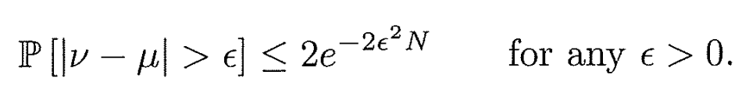
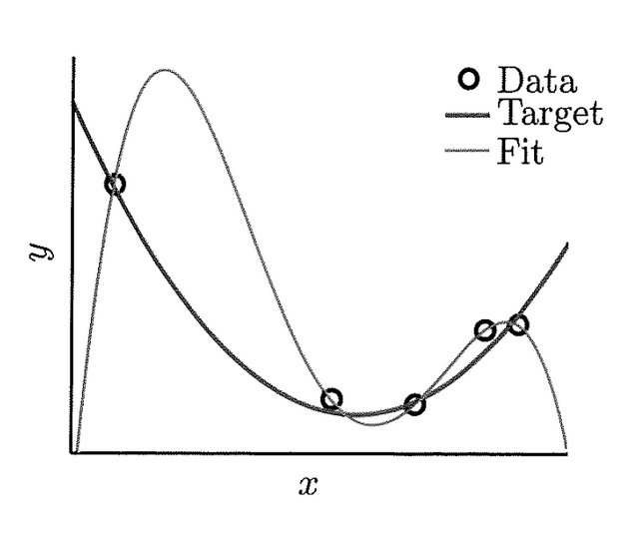
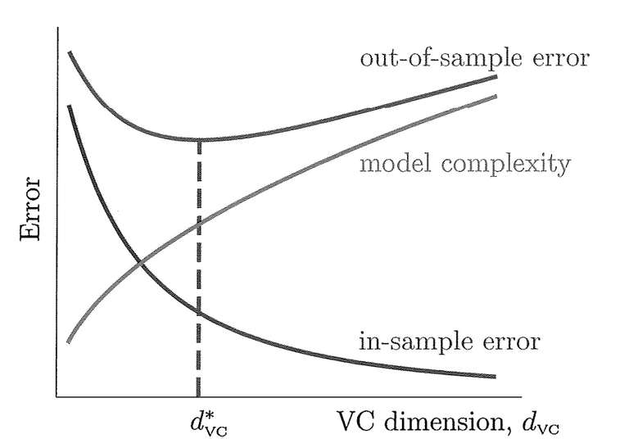
Machine Learning is the Study of Group/Population Level Analysis
Data Distribution: Hoeffding Inequality
Generalization
Overfitting and noise

Slide 4
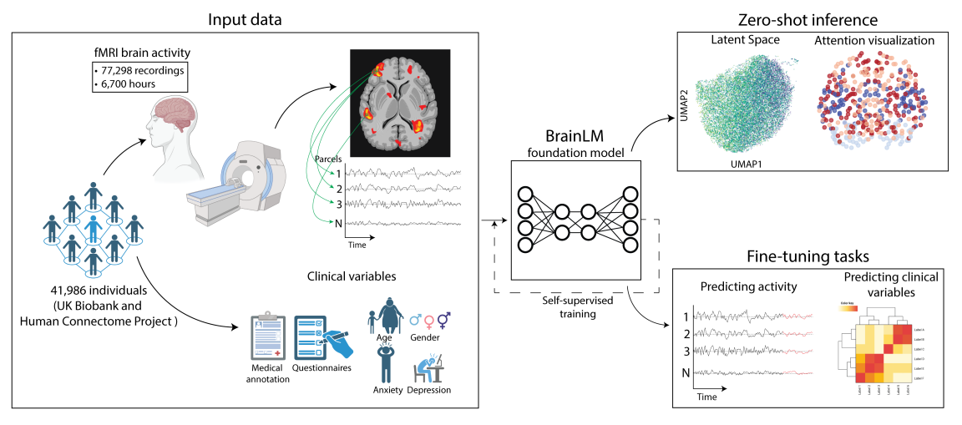
Foundation Model for Population level analysis

Slide 5
Datasets and Preprocessing
UK Biobank
HCP
Preprocessing
76,296 rs-fmri and t-fmri
1,002 high quality fmri recordings
motion correction, normalization, temporal filtering and ICA denoising
accompanied medical records
parcellated the brain into 424 regions using the AAL-424 atlas to extract parcel-wise time series
healthy adults scanned at 0.72s resolution
Siemens 3T scanner at 0.735s temporal resolution
424 dimensional scan sequences samples at ~1Hz
Demographic spanning ages 40 to 69
robust scaling was applied by subtracting the median and dividing by the interquartile range computed across subjects for each parcel.

Slide 6
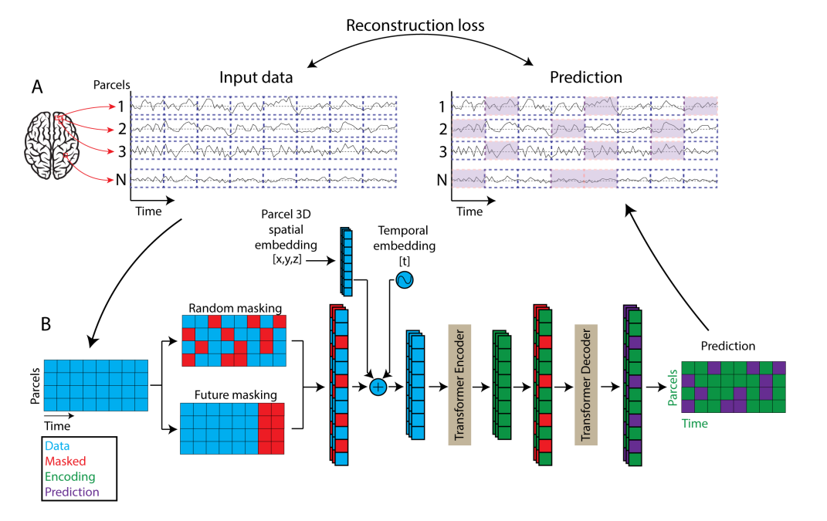
Model Architecture and Training Procedure

Slide 7
Clinical Variable Prediction
Augmented the pre-trained encoder with a 3-layer MLP head
Trained to regress targets such as age, neuroticism, PTSD, and anxiety disorder scores
Z-normalization scores for age
Neuroticism scores were through adjusted through min-max scaling, aligning the distribution in [0,1]
For both Post Traumatic Stress Disorder (PCL-5) and General Anxiety Disorder (GAD-7) scores, they first applied a log transformation to moderate their exponential distribution, followed by a min-max scaling

Slide 8
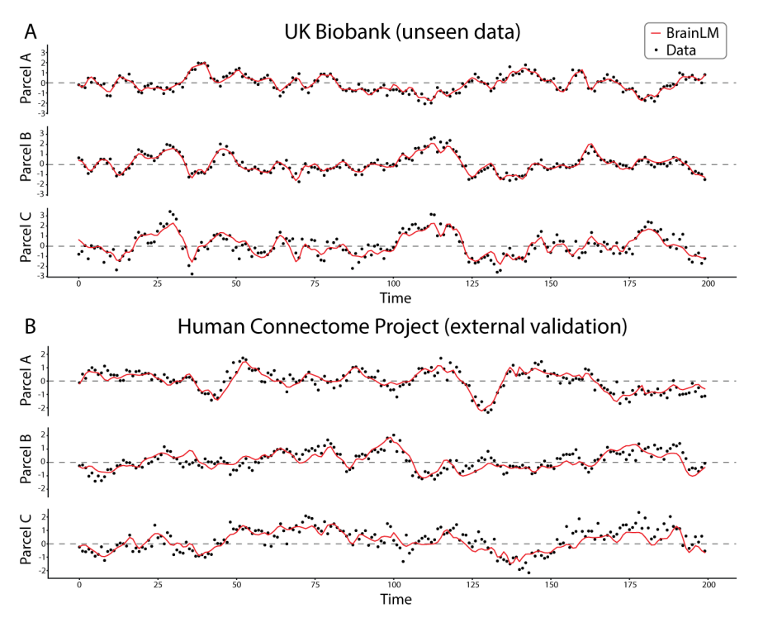
Model Generalization
R-squared score of 0.464 indicating strong generalization on unseen recordings from the same distribution
Generalized well to HCP dataset, despite differences in cohort and acquisition details
BrainLM could effectively model brain dynamics in this entirely new distribution
Model generalization scales with data size and model size

Slide 9
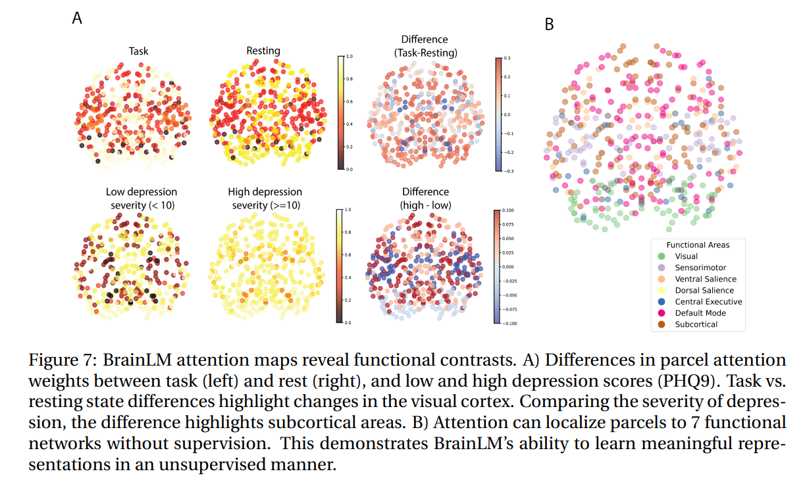
Interpretability via Attention Analysis

Slide 10
Discussion
This work presents BrainLM, the first foundation model for functional MRI analysis
leverages self-supervised pretraining on 6,700 hours of brain activity recordings
BrainLM demonstrates versatile capabilities for modeling, predicting, and interpreting human brain dynamics
BrainLM also provides a powerful framework for biomarker discovery
By fine-tuning, brain dynamics can be decoded to predict clinical variables and psychiatric disorders better than baseline models
Future work: multi-modal training could integrate fMRI with additional recording modalities, such as EEG and MEG, or different brain-wise information such as structural, functional, and genomic data.

Slide 11
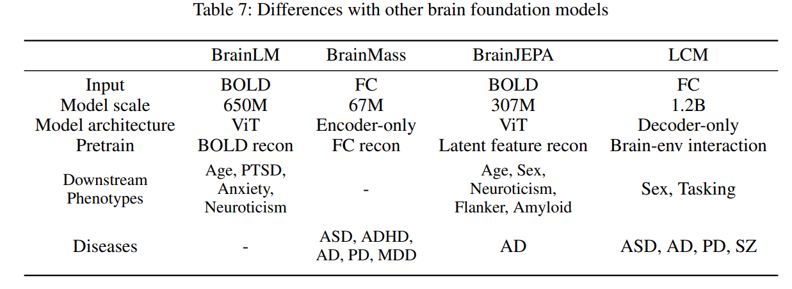
Limitations
Although existing brain foundation models (Ortega Caro et al. 2023; Dong et al. 2024) take the raw signal as input, the vast majority of related works (Cui et al. 2022; Said et al. 2023; Ding et al. 2024; Wei et al. 2024) suggest that brain connectomes as the input makes more accurate predictions for clinical applications.

